Slide 1

School of Computing Science and Engineering
Course Code : BSCS1240 Name: Object Oriented Programming with C++
UNIT III
Exception Handling
Object oriented programming concepts

Slide 2
Objective
Objective of this lecture -
Function and class templates –
Exception handling – try-catch-throw paradigm
exception specification – terminate and
unexpected functions – Uncaught exception.

Slide 3
Templates in C++
Function and class templates
A template is a simple and yet very powerful tool in C++. The simple idea is to pass data type as a parameter so that we don’t need to write the same code for different data types
Templates are expanded at compiler time.
C++ adds two new keywords to support templates: ‘template’ and ‘typename’. The second keyword can always be replaced by keyword ‘class’.

Slide 4
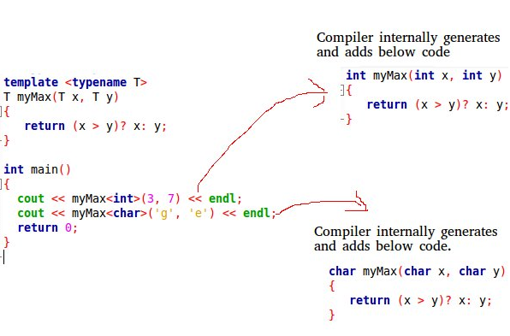
Templates in C++
Function and class templates
Example:

Slide 5
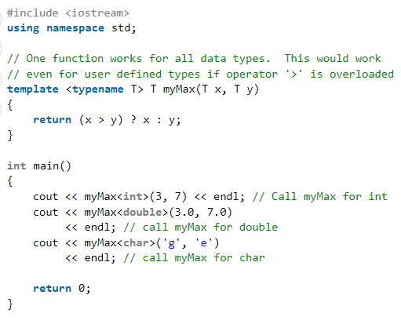
Function Template
Function Templates We write a generic function that can be used for different data types. Examples of function templates are sort(), max(), min(), printArray().

Slide 6
Function Template
Question: A template function to implement bubble sort. #include <iostream>
using namespace std;
template <class T> void bubbleSort(T a[], int n)
{
for (int i = 0; i < n - 1; i++)
for (int j = n - 1; i < j; j--)
if (a[j] < a[j - 1])
swap(a[j], a[j - 1]);
}

Slide 7
Function Template
int main()
{
int a[5] = { 10, 50, 30, 40, 20 };
int n = sizeof(a) / sizeof(a[0]);
bubbleSort<int>(a, n);
cout << " Sorted array : ";
for (int i = 0; i < n; i++)
cout << a[i] << " ";
cout << endl;
return 0;
}

Slide 8
Class Templates
Class Templates Like function templates, class templates are useful when a class defines something that is independent of the data type. Can be useful for classes like LinkedList, BinaryTree, Stack, Queue, Array, etc.
Following is a simple example of template Array class.
#include <iostream>
using namespace std;
template <typename T> class Array {
private:
T* ptr;
int size;
public:
Array(T arr[], int s);
void print();
};

Slide 9
Class Templates
template <typename T> Array<T>::Array(T arr[], int s)
{
ptr = new T[s];
size = s;
for (int i = 0; i < size; i++)
ptr[i] = arr[i];
}
template <typename T> void Array<T>::print()
{
for (int i = 0; i < size; i++)
cout << " " << *(ptr + i);
cout << endl;
}
int main()
{
int arr[5] = { 1, 2, 3, 4, 5 };
Array<int> a(arr, 5);
a.print();
return 0;
}

Slide 10
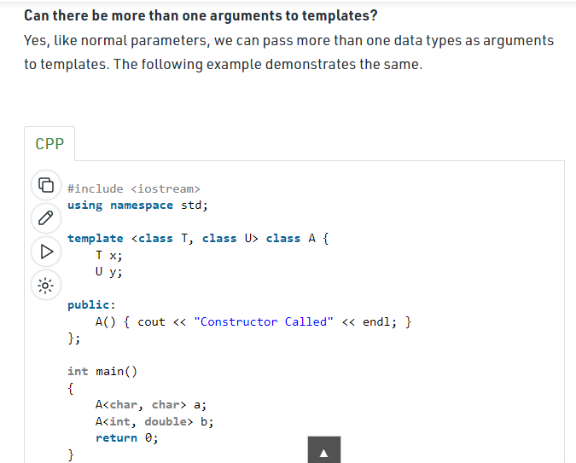
Class Templates

Slide 11
References
Object Oriented Programming with C++ - Rajiv Sahay, Oxford Mastering C++ - Venugopal, McGraw-Hill Education (India)
Herbert Schildt, C++ - The Complete Reference, Third Edition -Tata McGraw Hill - 1999.
Bruce Eckel, Thinking in C++, Second Edition, Volume One, Pearson Education Asia, 2000.
https://www.geeksforgeeks.org/templates-cpp/
Program Name: BSC

Slide 12


